Slide 1

Trajectory
WEEK 2 UPDATE
Lucas Thoms

Slide 2
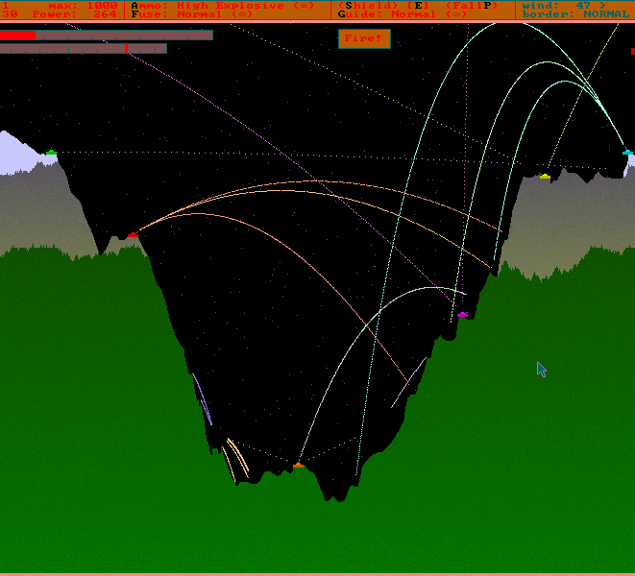
Inspiration

Slide 3
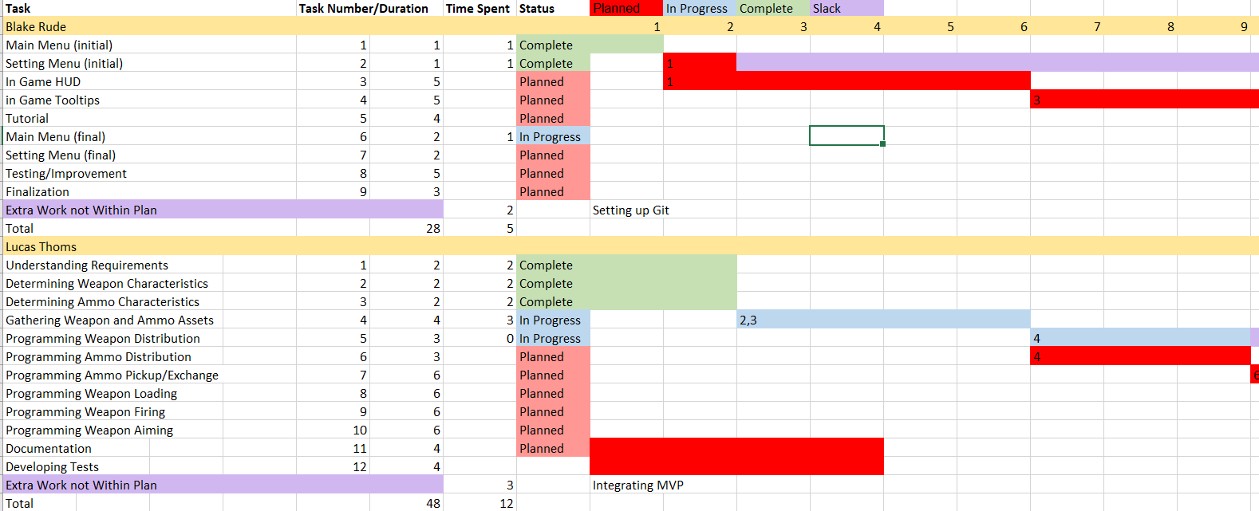
Progress

Slide 4
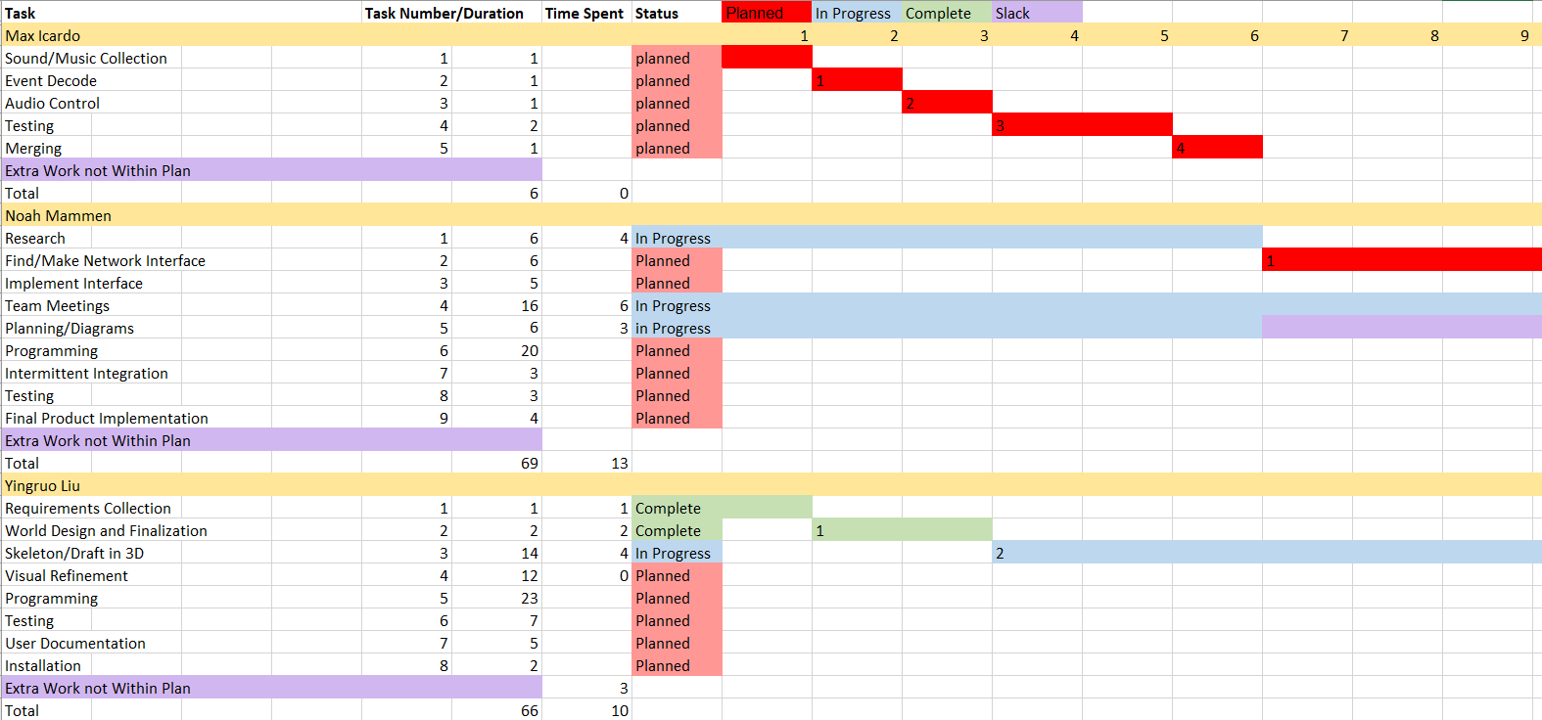
Progress

Slide 5
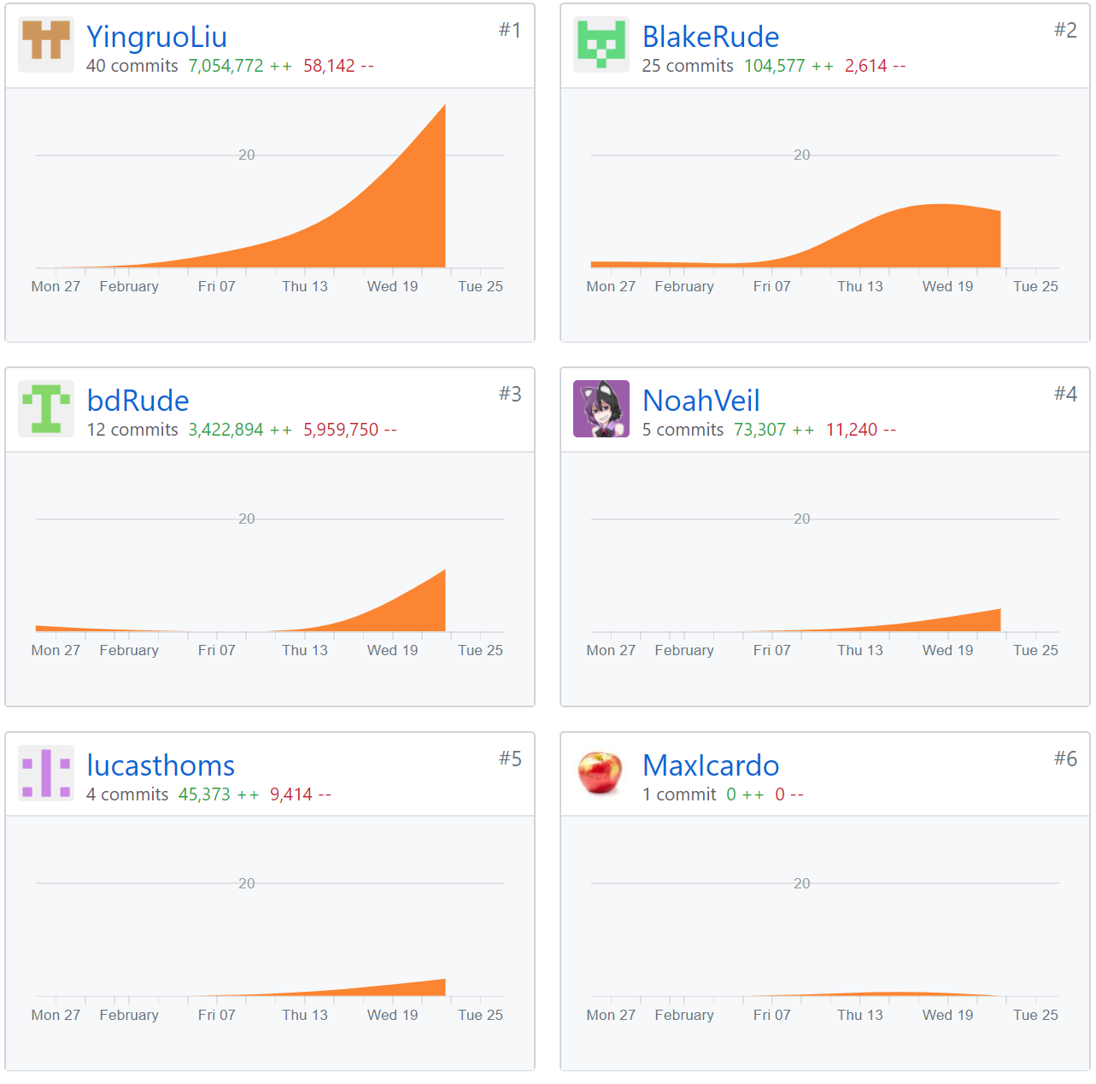
Progress

Slide 6
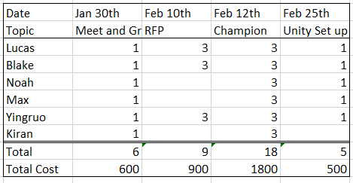
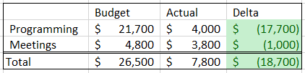
Progress

Slide 7
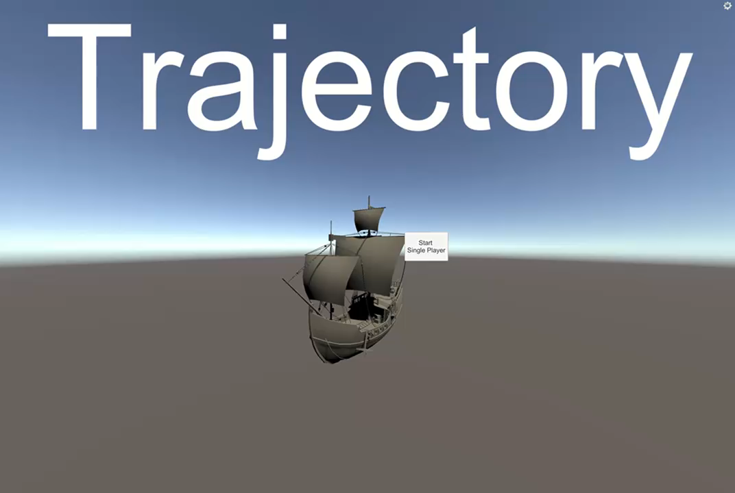
Gameplay

Slide 8
Trajectory
WEEK 2 UPDATE
Lucas Thoms

